Slide 2
1 Kings 18:20-24

Slide 3
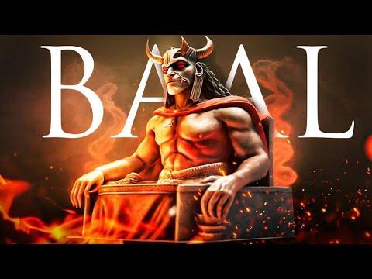

Slide 4
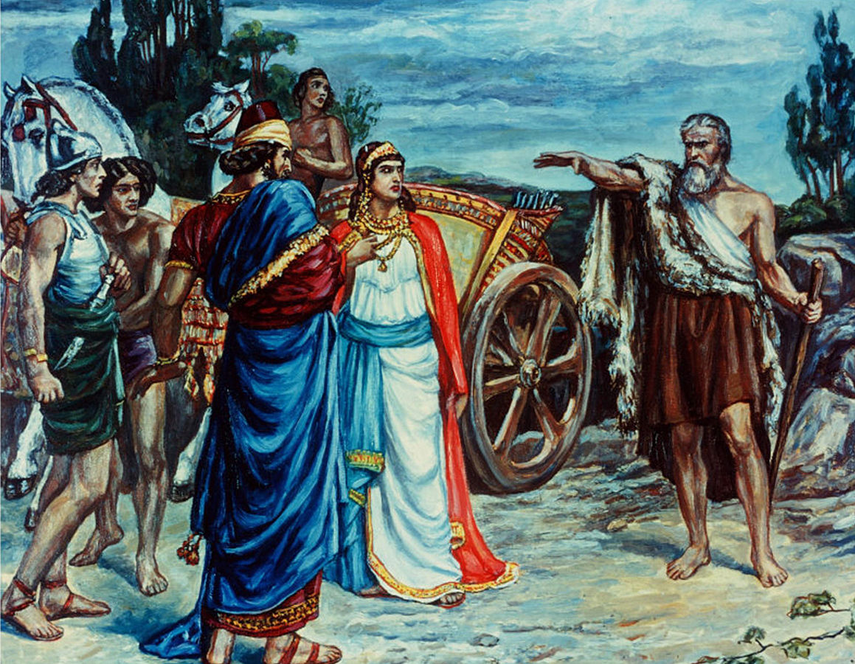

Slide 5
By Far The Majority\

Slide 6
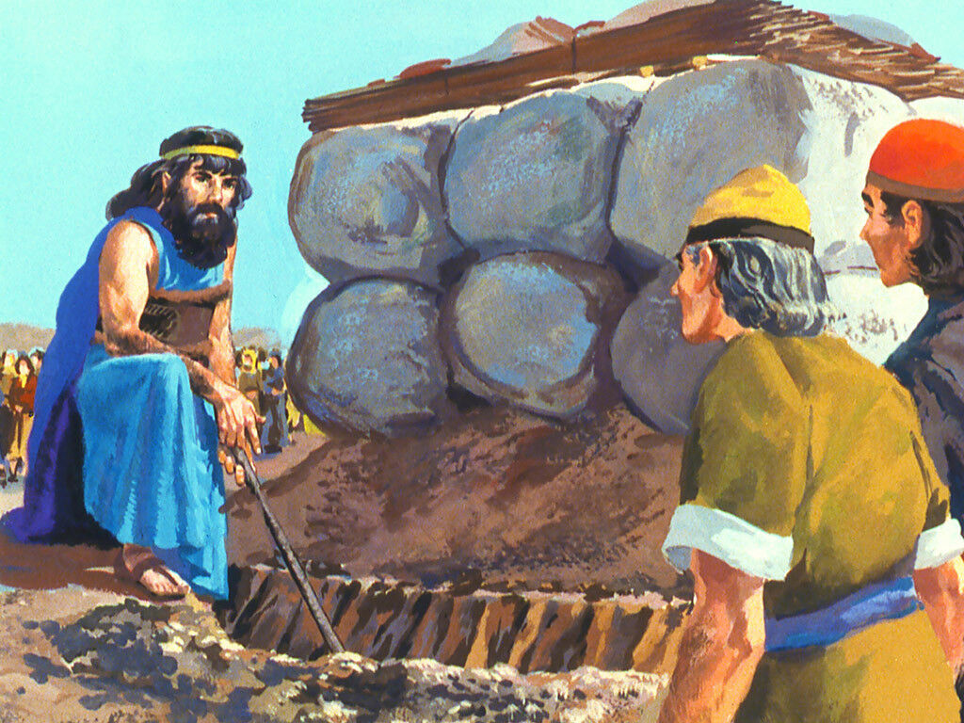
The Minority

Slide 7
1 Kings 18:25-39

Slide 8
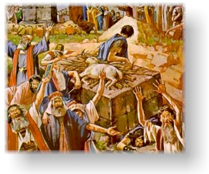

Slide 9
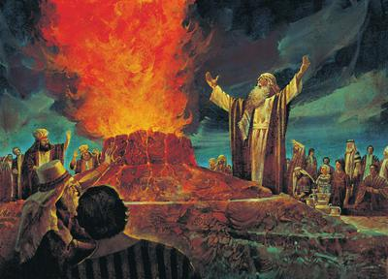
Succeeded almost instantly
Wet wood
Wet sacrifice
Wet ground
No harm to his person
No crying loud and long for hours

Slide 10
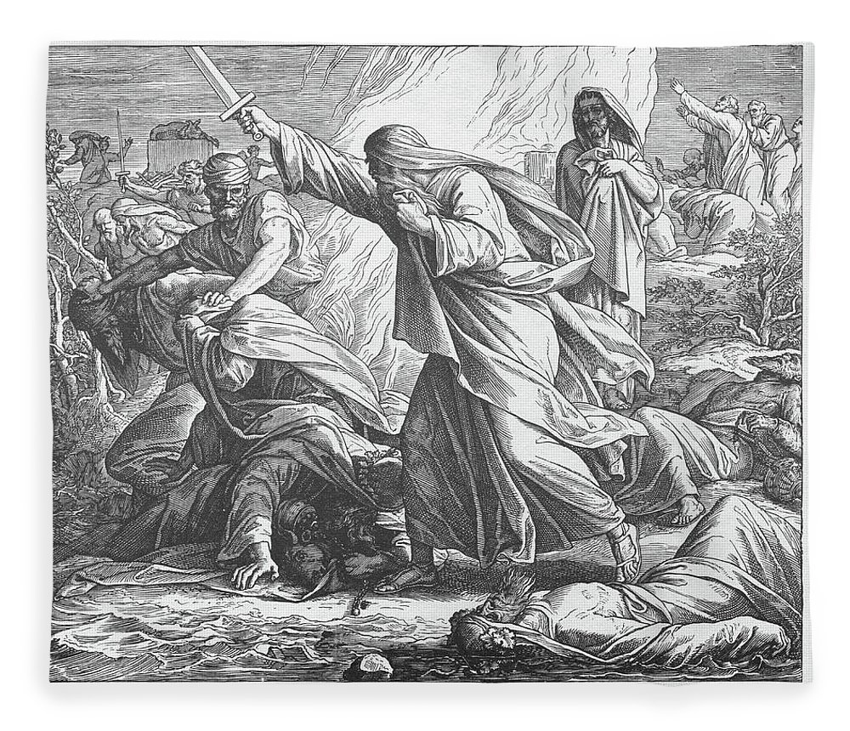
1 kings 18:40
"And Elijah said to them, "Seize the prophets of Baal! Do not let one of them escape!" So they seized them; and Elijah brought them down to the Brook Kishon and executed them there."

Slide 11
“troublers of israel”

Slide 12
Mechanical instruments of music
Question their authority – “church splitters” – “troublemakers”
Attempts to justify – “where does God say THOU SHAT NOT play on a mechanical instrument?” “I like it so I know God will like it!”
Appeal to Psalms of David – God was pleased with the harp, horn, flute and drum.
Same people are unwilling to burn incense or offering animal sacrifices in worship?
Christians told to SING – Colossians 3:16; Ephesians 5:19

Slide 13
Mechanical instruments of music
Until the eighth century the religious world in general did not use such instruments in worship!
Leaders of the “Protestant Movement” opposed any such use: “I would just as soon PRAY to God with an instrument as SING to God with an instrument.”
Who were the “troublers of Israel?”
The ones OPPOSED to the innovation or the ones who BROUGHT IT IN?
Fellowship cannot exist between those who they MUST HAVE IT!

Slide 14
Human institutions an adjunct to the church
Missionary Societies, Aid Societies, Social Organizations, Sponsoring Church arrangements, etc.
Fulfill some purpose which the church in and of itself could not accomplish – SO God gave the local church a work to do which it was not equipped to do!
Philippians 4:15-18 – support evangelism with God’s approval
Without any SUPER ORGANIZATION to coordinate evangelism to collect money from congregations
They sent the support DIRECTLY TO HIM – no intermediary

Slide 15
Human institutions an adjunct to the church
Benevolence in the local church – 1 Timothy 5:16
Clear distinction between INDIVIDUAL and COLLECTIVE
Help needy saints elsewhere – Romans 15:25,26
Contribution for the POOR AMONG SAINTS – not for GENERAL BENEVOLENCE
No passage in the New Testament that places the responsibility of GENERAL BENEVOLENCE on the local church
“You people who are opposing these institutions are SPLITTING THE CHURCH!” Sound familiar?

Slide 16
Human organizations conducting gospel meetings and supporting preachers
“Troublers of Israel bent on destroying what is left of the remnant of the church today!”
Church designed from eternity – Ephesians 3:10,11
Being designed by God – it is sufficient to accomplish everything the Lord intended for it to accomplish
When men step outside the divine plan, and try to accomplish what the church was designed by God to do, they have become the “troublers of Israel!”

Slide 17

The majority worshiping at the altar of baal today
Does That Make It Right?
Matthew 7:13; 15:9

Slide 18
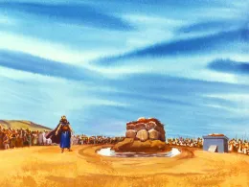
The minority are worshiping at god’s altar today
Matthew 7:14
At which altar are you worshiping?

